Slide 1

“MUSIC MANAGEMENT”
A DATABASE PROJECT BY-
SOFIYA KHAN,
ABHAY RAJ DIXIT

Slide 2
INTRODUCTION
WHAT IS IT ABOUT?
The music database is to categorise and catalogue every single piece of music for music info ,Rate and review albums, listing record collection, singers, their songs, languages sung and much more.
WHY WE CHOSE IT?
The idea of music database arose out of common interest of project members in MUSIC(Sangeet).The concept seemed different and very interesting right in the first go.

Slide 3
LET’S GET STARTED!

Slide 4

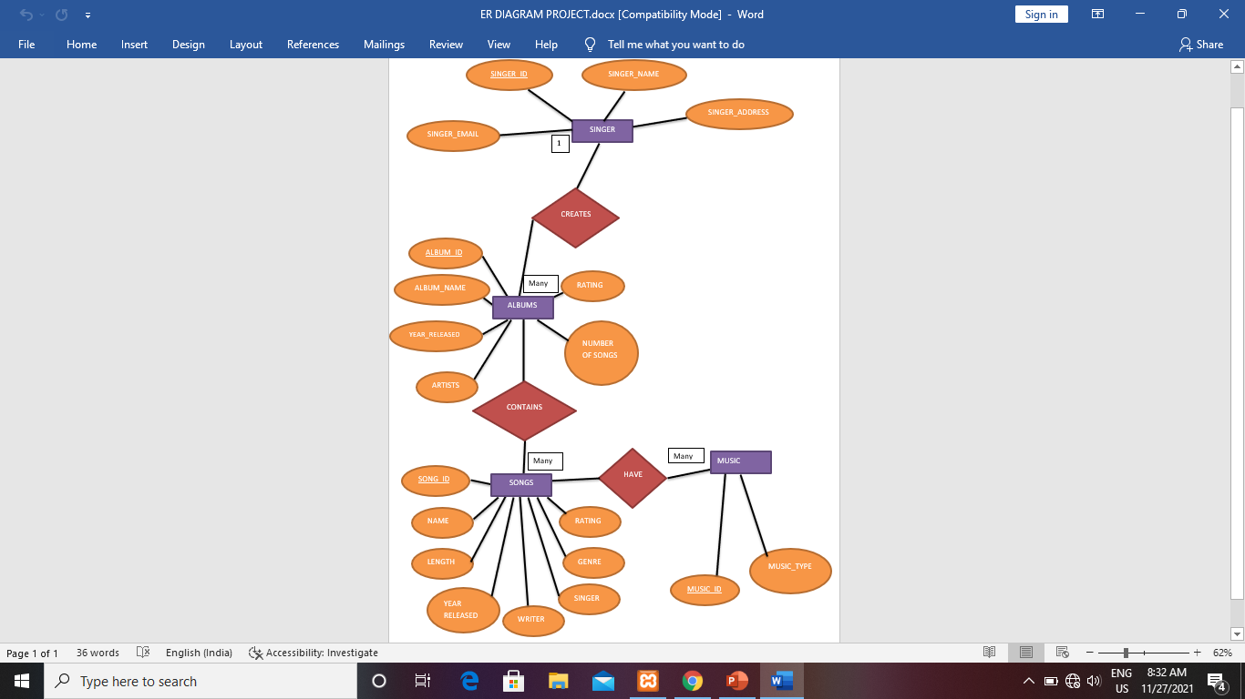
E-R DIAGRAM

Slide 5
ENTITIES ,ATTRIBUTES AND RELATIONSHIP
ENTITIES | ATTRIBUTES
Singer | Singer_id | Singer_name | Languages_ sung
Albums | Album_id | Album_name | artists | No.of songs | rating | Year_ released
Songs | Song_id | Song_name | Song_length | Year_released | writer | singer | genre | rating
Music | Music_id | Music_type
PRIMARY KEY
PRIMARY KEY
RELATIONSHIP
SINGER CREATES ALBUMS
ALBUMS CONTAINS SONGS
SONGS HAVE MUSIC

Slide 6
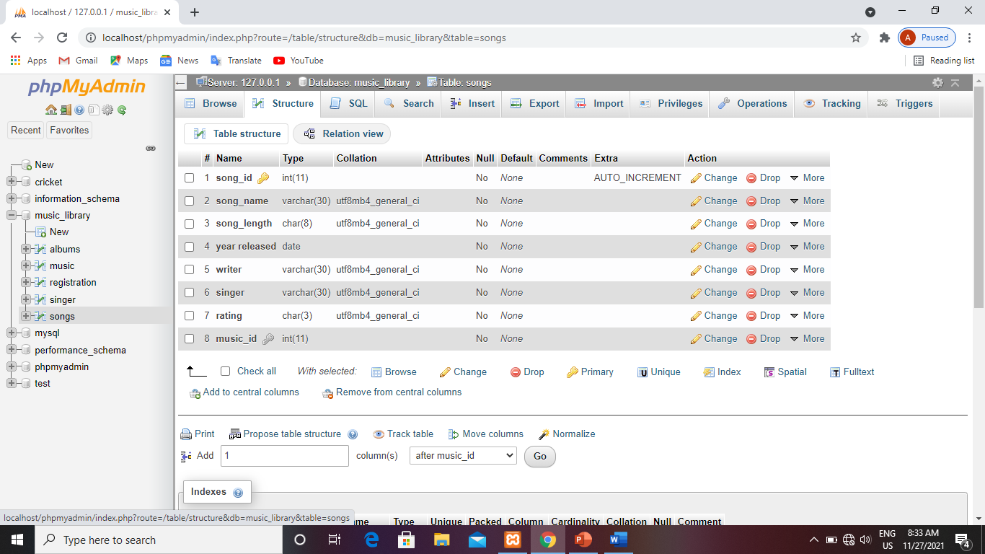
SONG TABLE:

Slide 7
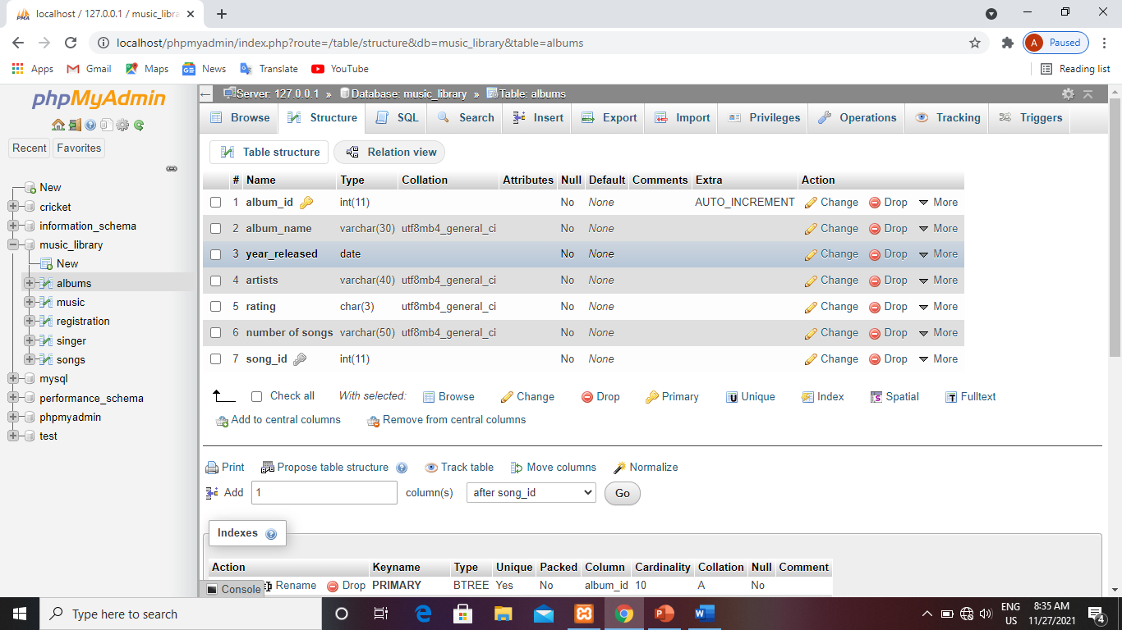
ALBUMS TABLE:

Slide 8
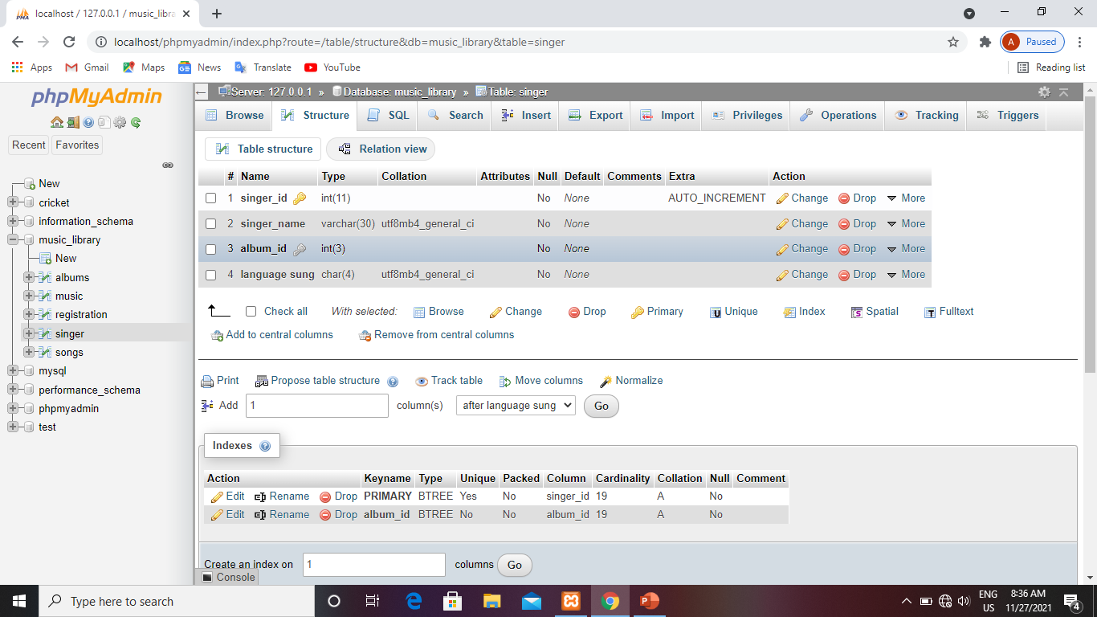
SINGER TABLE:

Slide 9
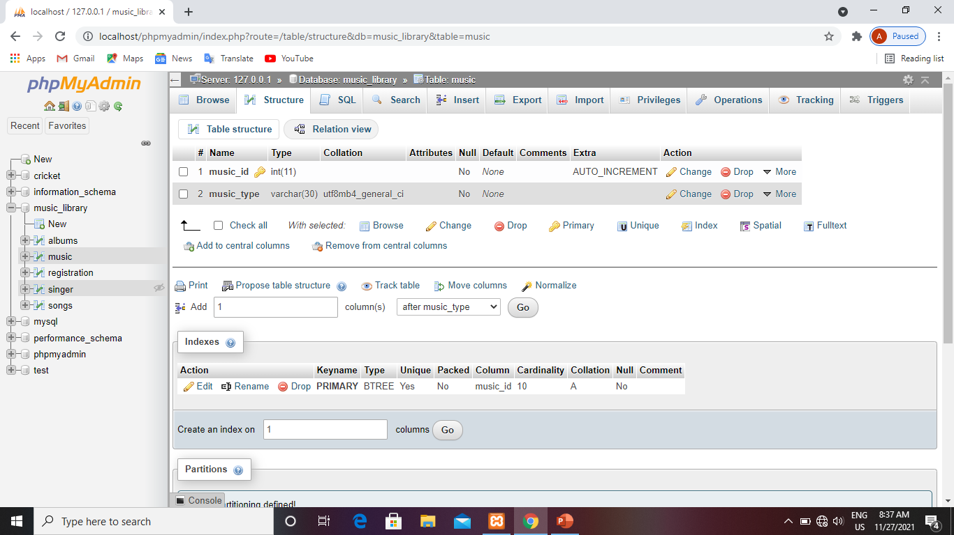
MUSIC TABLE:

Slide 10

HOMEPAGE OF OUR WEBSITE:

Slide 11
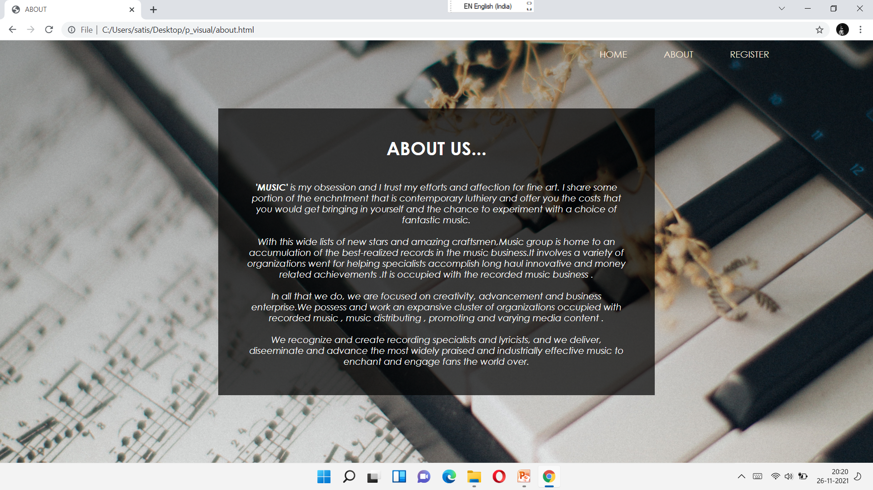
ABOUT PAGE:

Slide 12
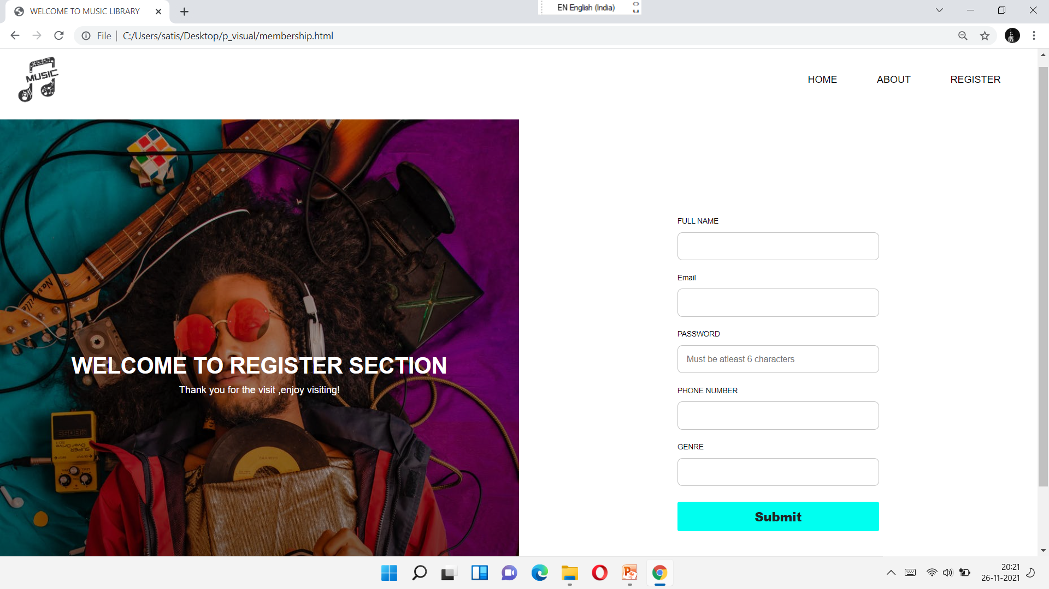
REGISTRATION SECTION OF OUR TABLE:

Slide 13

FEEDBACK SECTION OF OUR TABLE:
p_visual\index.html

Slide 14
CONCLUSION:
The project MUSIC MANAGEMENT is for computerizing all the data and information related to music for music lovers.
The software takes care of all the requirements and is capable to provide easy and effective storage of information to users.

Slide 15

THANK YOU!

